Slide 1
MACHINE LEARNING BASED SUSPICIOUS FRAME CLASSIFICATION FROM SURVEILLANCE VIDEO
MCA
2019202026 Guide
Karthicksankar K Dr.P Geetha

Slide 2


Slide 3
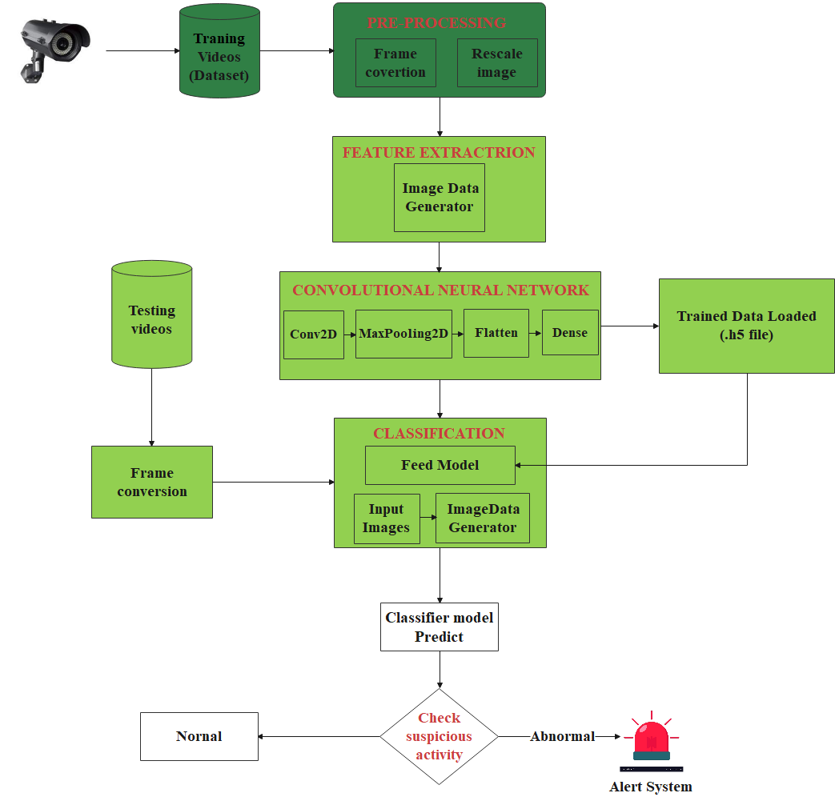

Slide 4
MODULES
Video Acquisition
Pre-processing
Feature Extraction
Classification

Slide 5
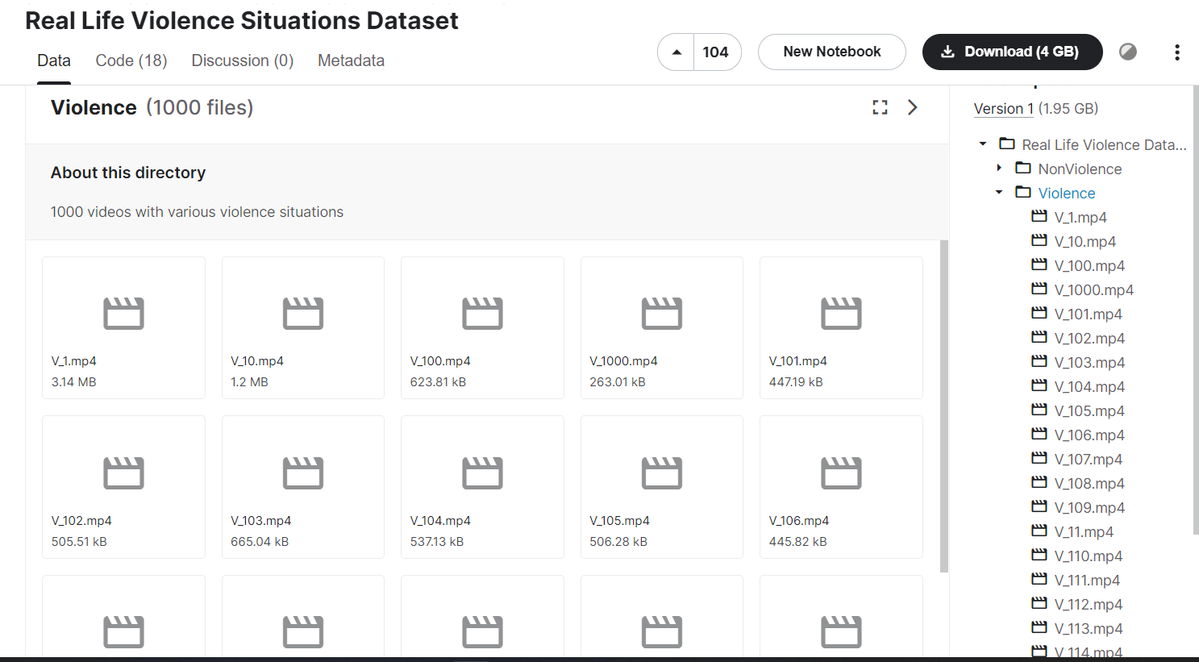
Video Acquisition
Acquisition is the process of collection of videos.
These videos are getting from the Kaggle.com and YouTube
https://www.kaggle.com/datasets/mohamedmustafa/real-life-violence-situations-dataset/code

Slide 6
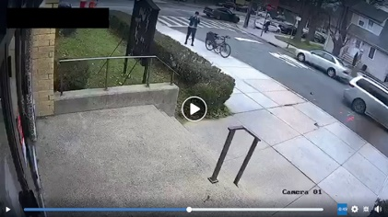
Pre-Processing
Pre-processing make ready data for the training process.
Frame conversion
Rescale image
Input : Video dataset (violence and non-violence).
Output : Save images in the folder.
Images Saved
Frame conversion
Rescale image (.jpg)

Slide 7
Algorithm for pre-processing
Step 1: | Given a input video
Step 2: | Read the video
Step 3: | Video split into frame
Step 4: | for each image load from folder
Step 5: | Save image .jpg format
Step 6: | end

Slide 8
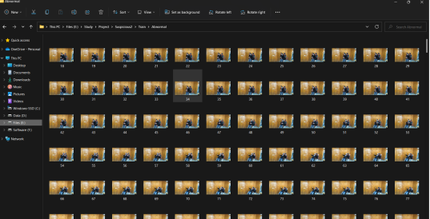
Feature Extraction
Major point of training model created.
Image data generator
Convolutional neural network (CNN)
Input : Pre-processing video frames.
Output : Trained Model has been created.
Trained
Model
Data Generator
CNN

Slide 9
Algorithm for feature extraction
Step 1: | Given a input video frames on Train and Test
Step 2: | Resize the image to 64*64
Step 3: | for each image in the folder
Step 4: | Initiation CNN
Step 5: | Generate activation map using negative values are dropped using relu Input_shape=(64,64,3)
Step 6: | Reduce activation map by selecting max value using Maxpooling layer

Slide 10
Step 8 : | Extract shapes and angles using 2nd Convolution layer
Step 9 : | Reduce activation map by selecting max value using 2nd Maxpool layer
Step 10 : | Flattern activation map using flattern layer
Step 11 : | Dense map is generated using dense layer
Step 12 : | Finally 2nd dense map generated 1 class using Sigmod activation
Step 13 : | Model was stored weights in .h5 file

Slide 11
Classification
The Model can classified here using predict function.
Frame conversion
Image data generator
Feed trained model
Classifier the frames
Input : Testing video
Output : Predict Normal and Abnormal frame.

Slide 12
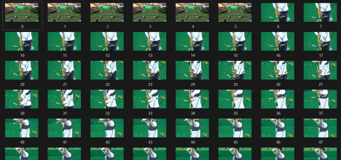

Testing
video
Data
Generator
Feed
Model (.h5)
if value
> 0.5
Value=Model.
predict(img_val)
Abnormal
False
Alert System
True
Normal

Slide 13
Algorithm for classification
Step 1: | Feed the pre-trained model
Step 2: | Given a input video
Step 3: | Split the video into frames
Step 4: | for each image load
Step 5: | Read frames store (.jpg) in a folder
Step 6: | Load the image size(64,64)
Step 7: | Image change to matrix Img = current_frame_val/255
Step 8: | Predict current image using trained model. Val=Model.predict(img)

Slide 14
Step 9: | if val > 0.5 print(normal)
Step 10: | else print(abnormal) end if
Step 11: | Current_frame +=1
Step 12: | end for

Slide 15
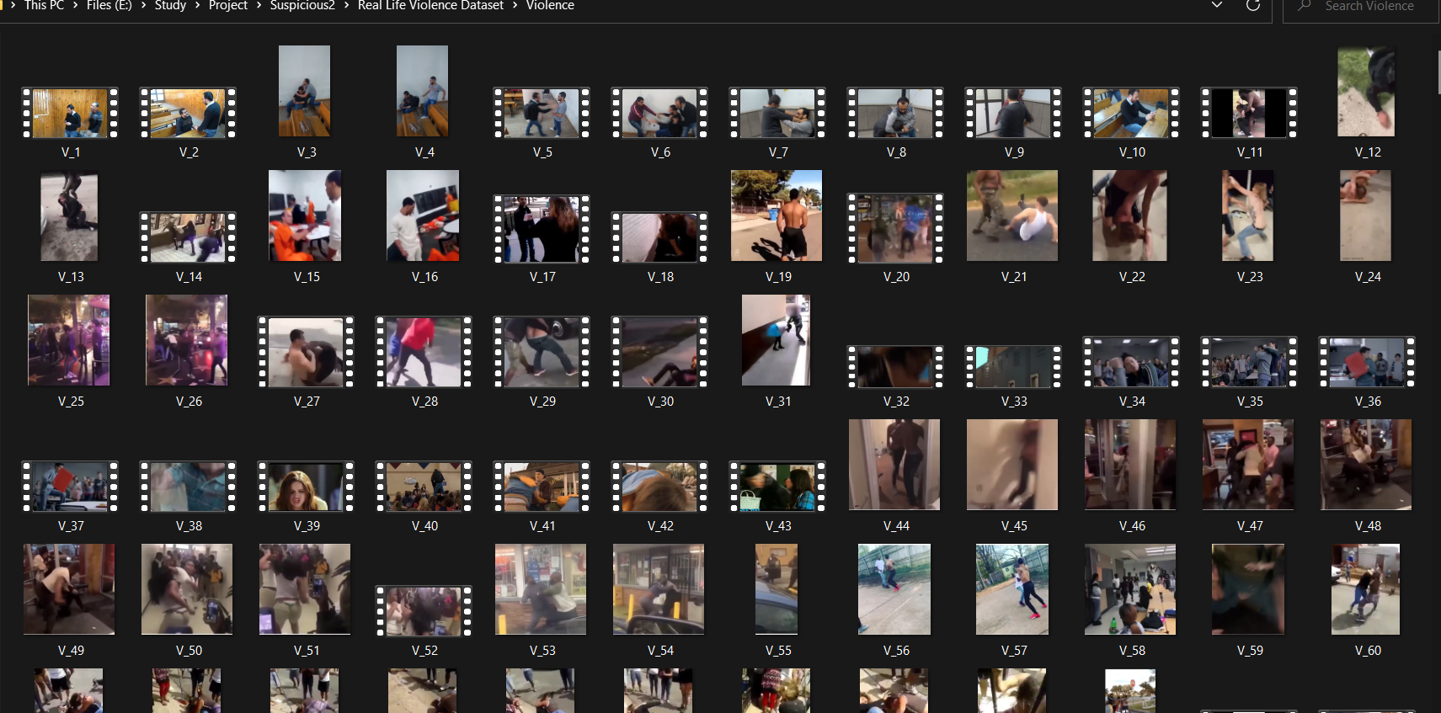
Output
Video Acquisition

Slide 16
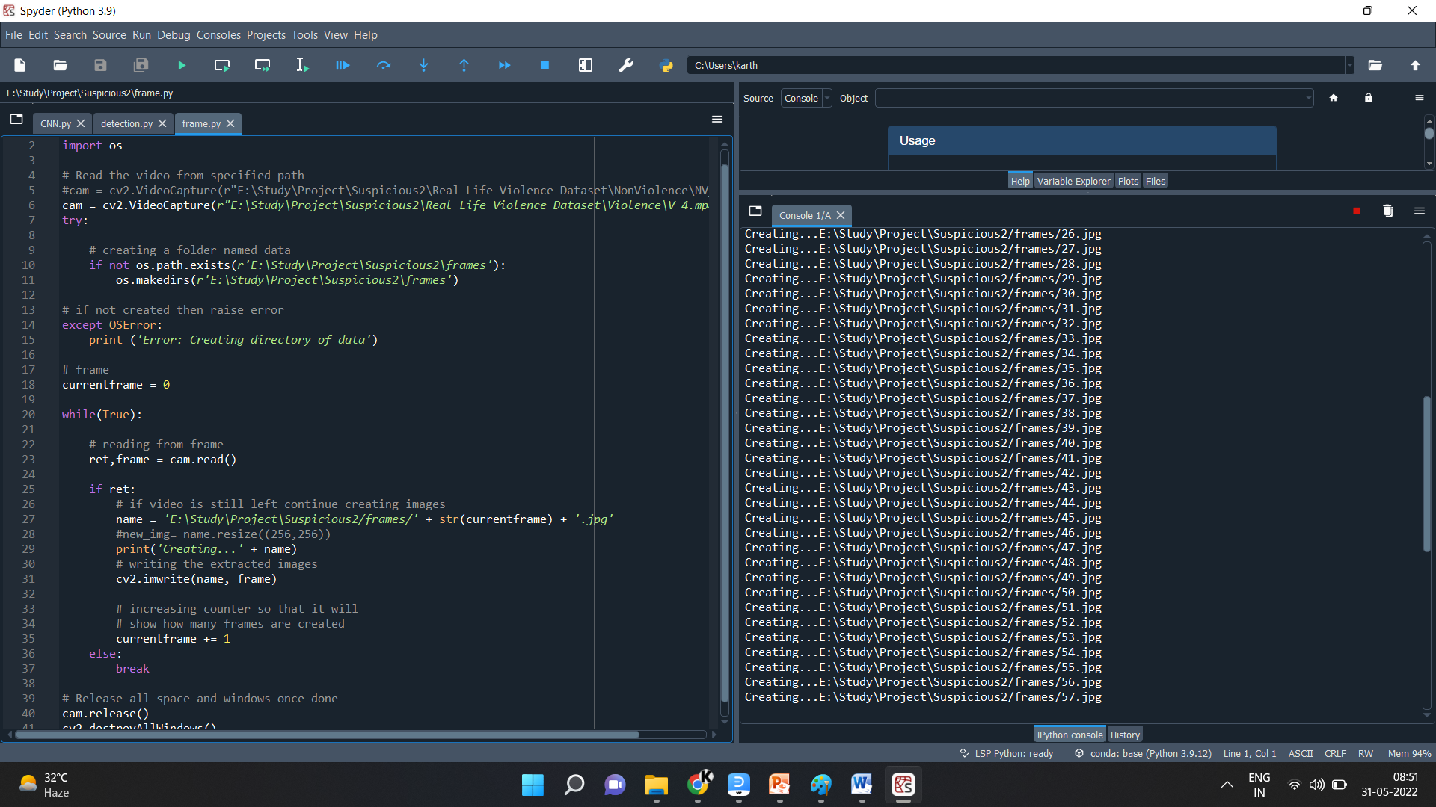
Pre-processing

Slide 17
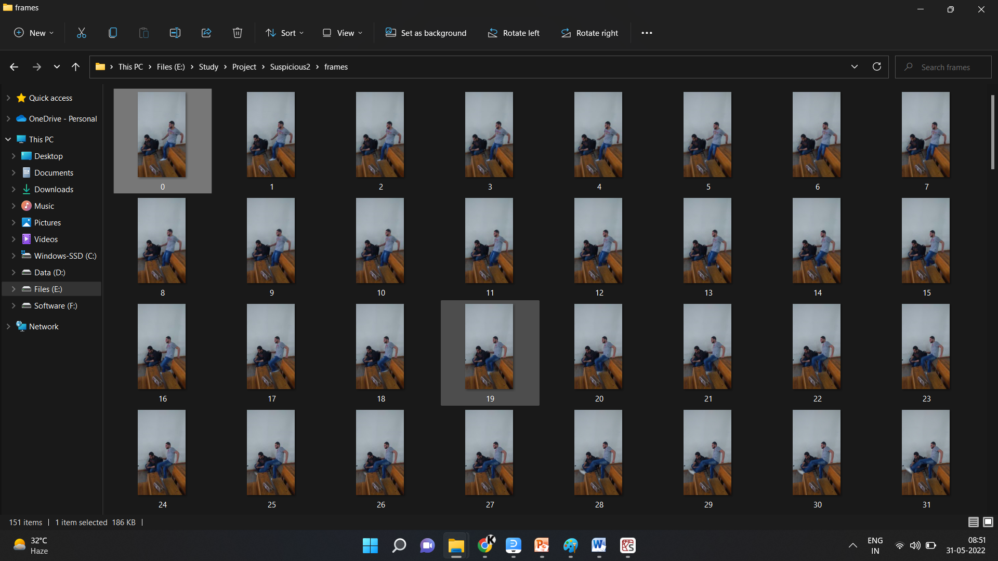

Slide 18
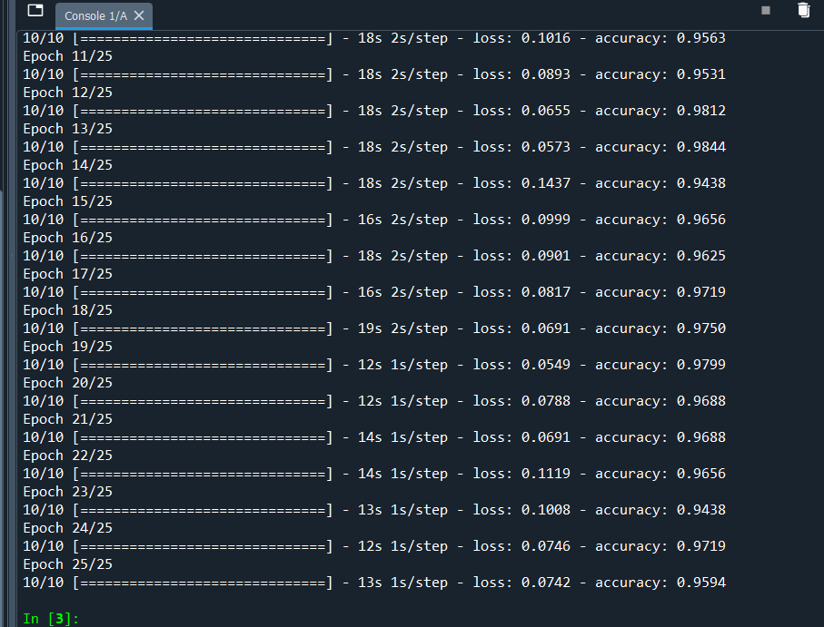

Feature Extraction
Here load the trained data in Trained_model.h5

Slide 19
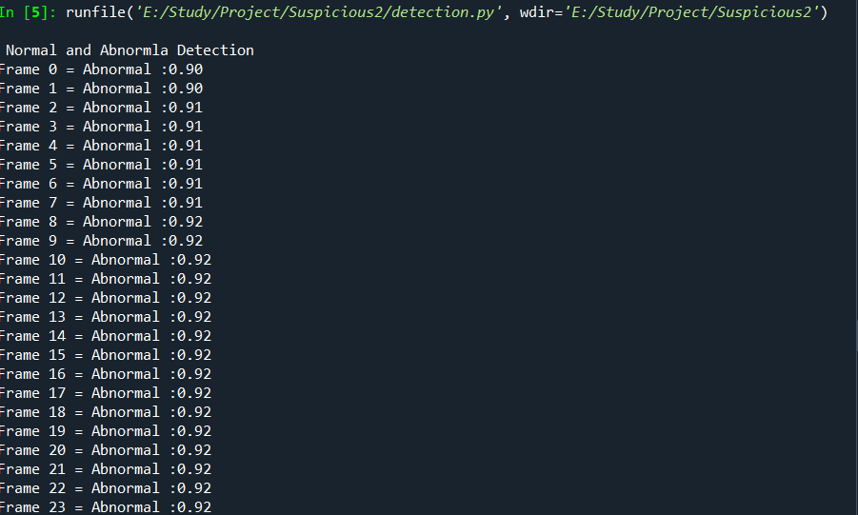
Classification
Abnormal detection

Slide 20
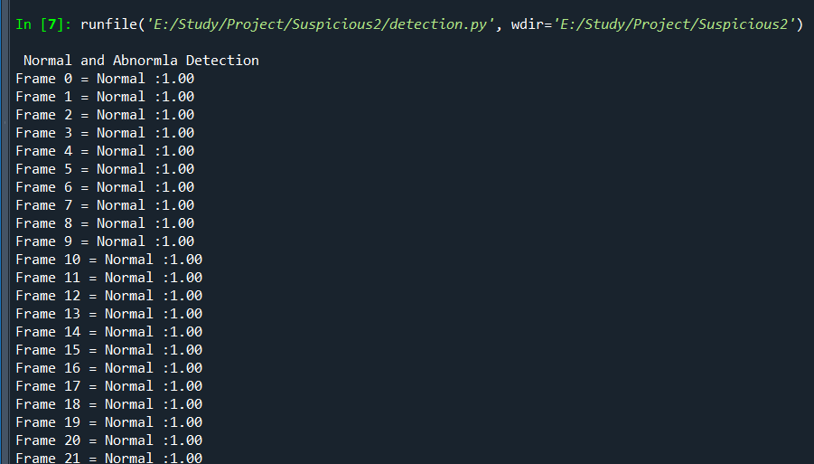
Normal detection

Slide 21


